Slide 1
COVID-19 Dashboard
File created on: 10/7/2021 9:13:15 PM

Slide 2
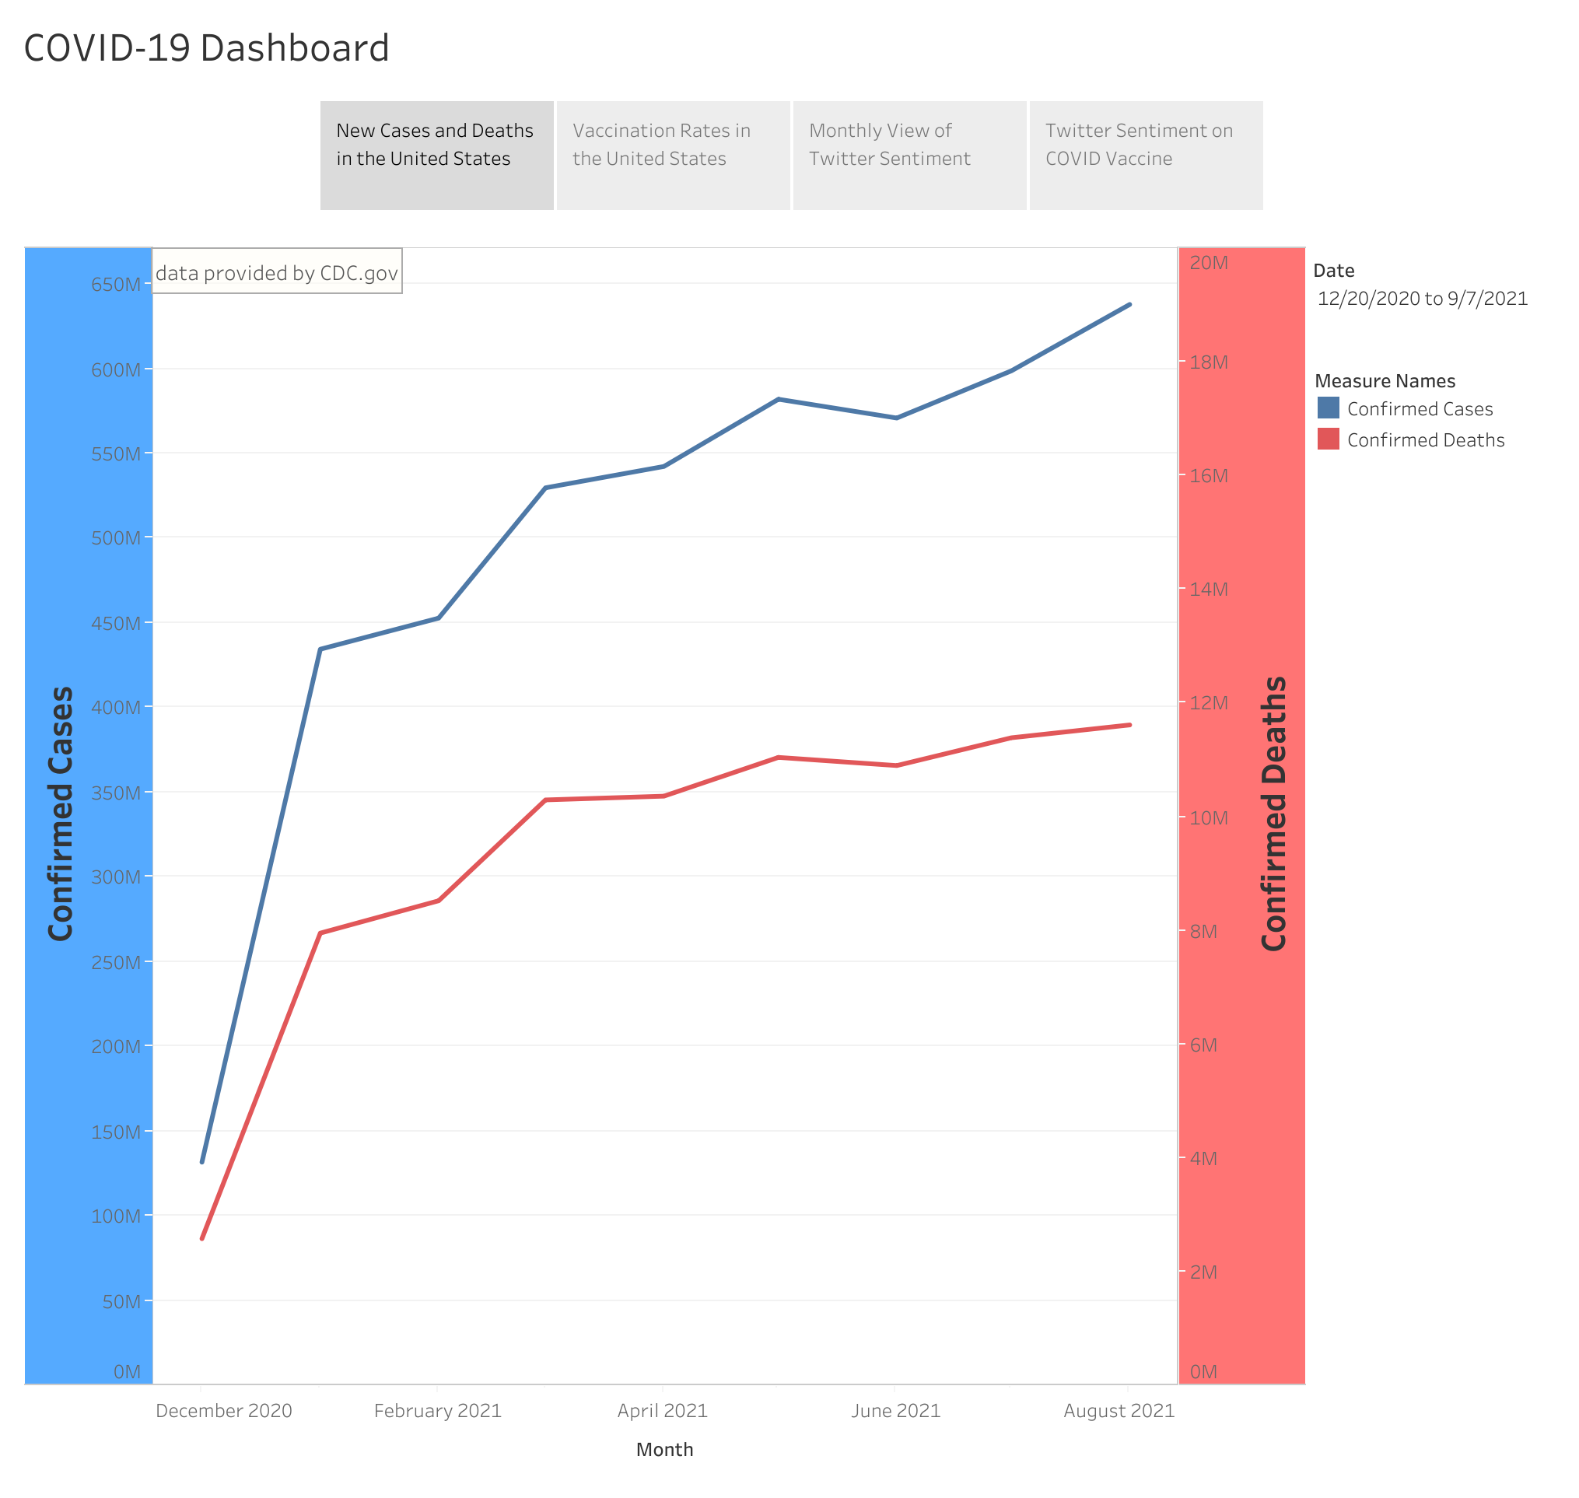

Slide 3
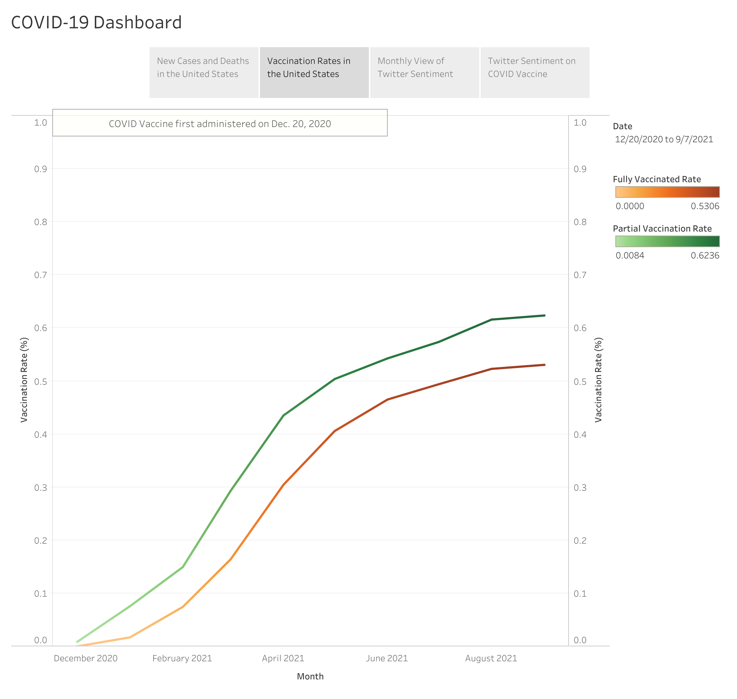

Slide 4
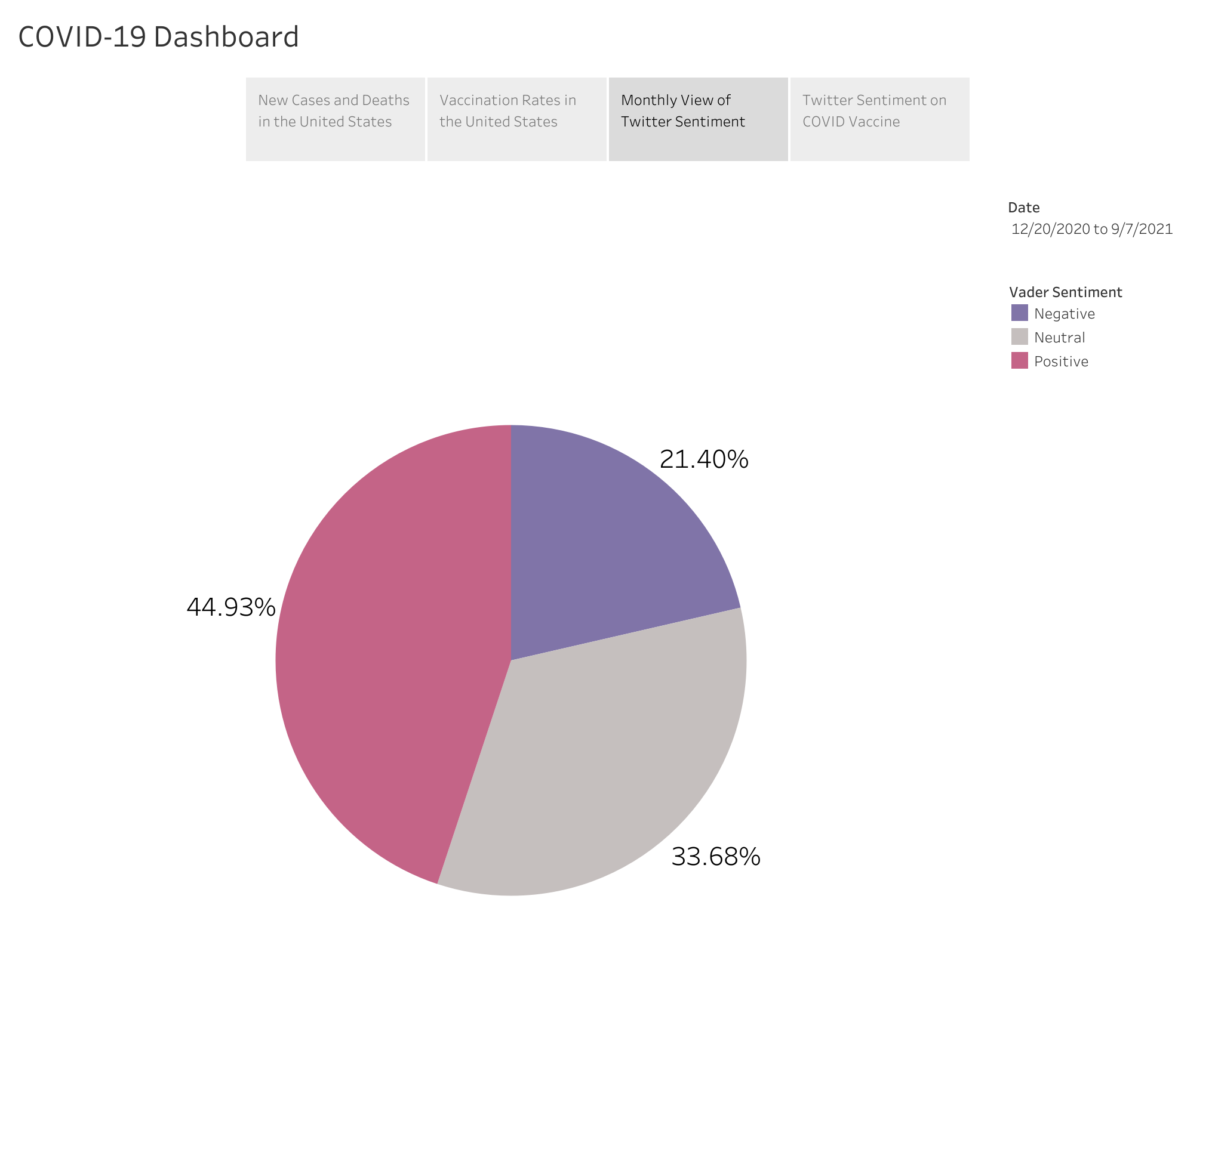

Slide 5
